Slide 1
Unit 5 Series Circuits
Part C: Analysis of Series Circuits
Notes:
Hi! Welcome to Unit 3: Resistance and Ohm’s Law, Part A on Resistance.

Slide 2
What will you learn?
Apply concepts of circuit nodes and circuit loops, voltage rise and voltage drop, equivalent resistance, Ohm's law, Kirchhoff's Voltage Law (KVL), and Voltage Divider Rule (VDR) for circuit calculations.

Slide 3
Recapitulation of Part B:
Concepts of circuit node, circuit loop, voltage rise and voltage drop.
These concepts are used to define Kirchhoff’s Voltage Law.
KVL: In a closed circuit loop, the sum of all voltage rises = the sum of all voltage drops.

Slide 4




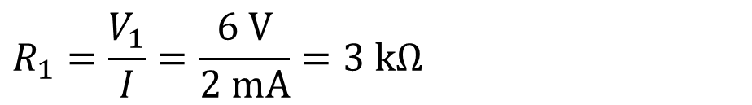
_
Example 1: Calculate R₁.
I = 2 mA
+
$V_{1}$
By KVL,
$$R_{1}$$
+
_
$$V_{S}=V_{1}+V_{2}+V_{3}$$
$$R_{2}$$
2 V
+
_
1 kΩ
$$12=V_{1}+2+4$$
12 V
$$V_{1}=6 V$$
+
_
$$R_{3}$$
$$R_{1}=\frac{V_{1}}{I}=\frac{6 V}{2 mA}=3 kΩ$$
4 V
2 kΩ

Slide 5
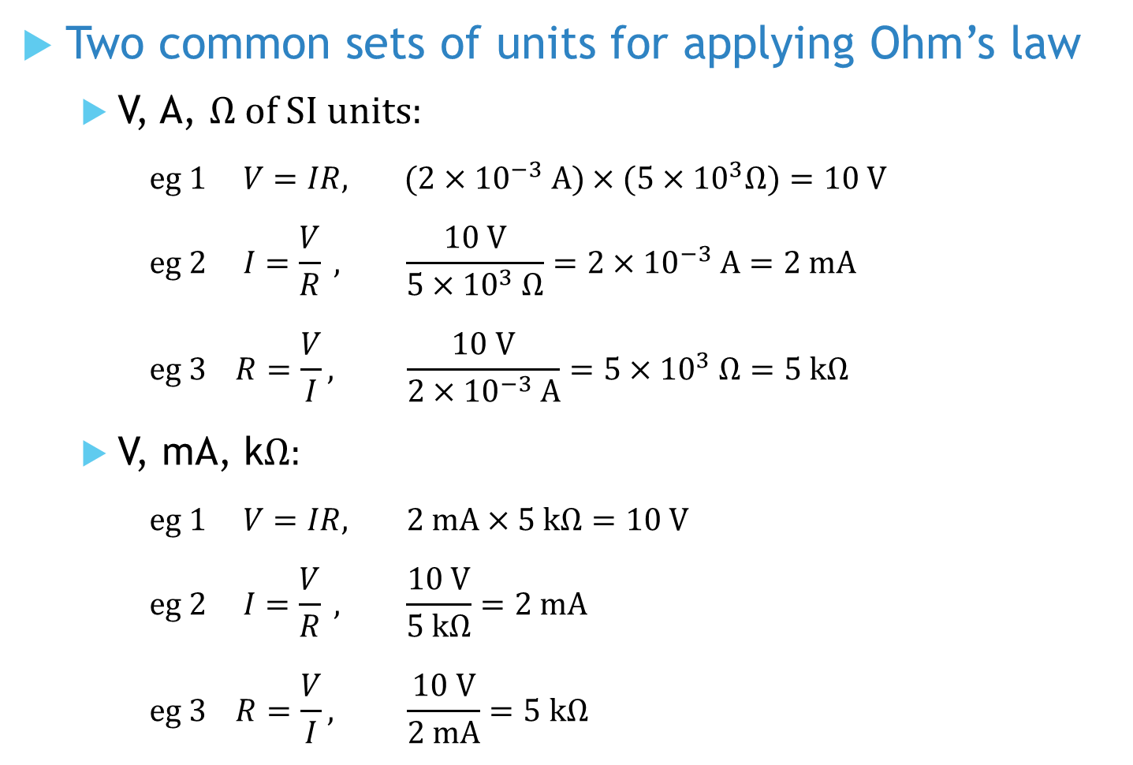
Two common sets of units for applying Ohm’s law
V, A, Ω of SI units:
$$eg 1 V=IR, (2×{10}^{−3} A)×(5×{10}^{3}Ω)=10 V$$
$$eg 2 I=\frac{V}{R} , \frac{10 V}{5×{10}^{3} Ω}=2×{10}^{−3} A=2 mA$$
$$eg 3 R=\frac{V}{I}, \frac{10 V}{2×{10}^{−3} A}=5×{10}^{3} Ω=5 kΩ$$
V, mA, kΩ:
$$eg 1 V=IR, 2 mA×5 kΩ=10 V$$
$$eg 2 I=\frac{V}{R} , \frac{10 V}{5 kΩ}=2 mA$$
$$eg 3 R=\frac{V}{I}, \frac{10 V}{2 mA}=5 kΩ$$
More convenient sometimes

Slide 6
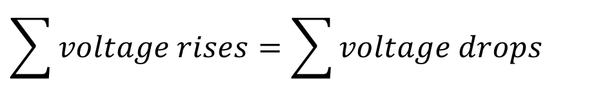




Example 2: Calculate the voltage drop across the resistor.
I
By KVL,
A
$$\sum{voltage rises=\sum{voltage drops}}$$
+
_
6 V
$$6 V+9 V=V_{R}+12 V$$
+
_
D
$$R$$
$$V_{R}$$
$$V_{R}=3 V$$
+
_
12 V
C
_
B
+
9 V

Slide 7
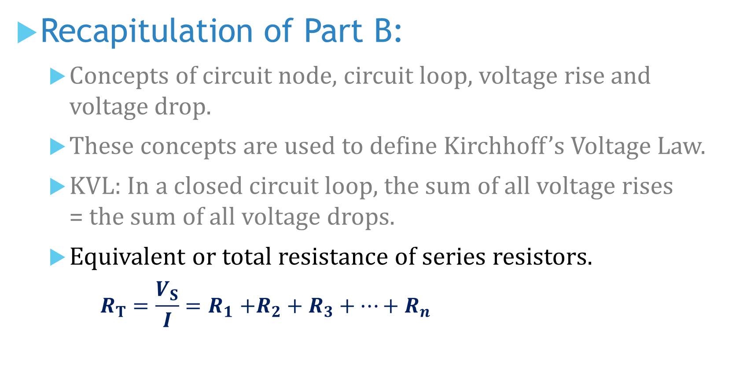
Recapitulation of Part B:
Concepts of circuit node, circuit loop, voltage rise and voltage drop.
These concepts are used to define Kirchhoff’s Voltage Law.
KVL: In a closed circuit loop, the sum of all voltage rises = the sum of all voltage drops.
Equivalent or total resistance of series resistors.
$$R_{T}=\frac{V_{S}}{I}{=R}_{1}+R_{2}+R_{3}+⋯+R_{n}$$

Slide 8
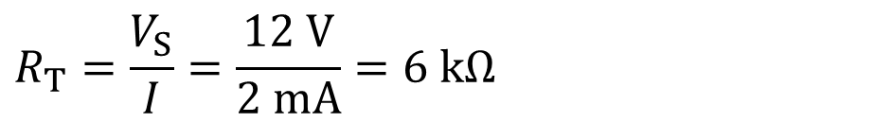




Example 3: Calculate R₁.
I = 2 mA
$V_{1}$
_
+
$$R_{T}=\frac{V_{S}}{I}=\frac{12 V}{2 mA}=6 kΩ$$
$$R_{1}$$
+
_
$$R_{2}$$
$$∴R_{1}+1 kΩ+2 kΩ=6 kΩ$$
2 V
+
_
1 kΩ
$$R_{1}=3 kΩ$$
12 V
+
_
$$R_{3}$$
4 V
2 kΩ

Slide 9
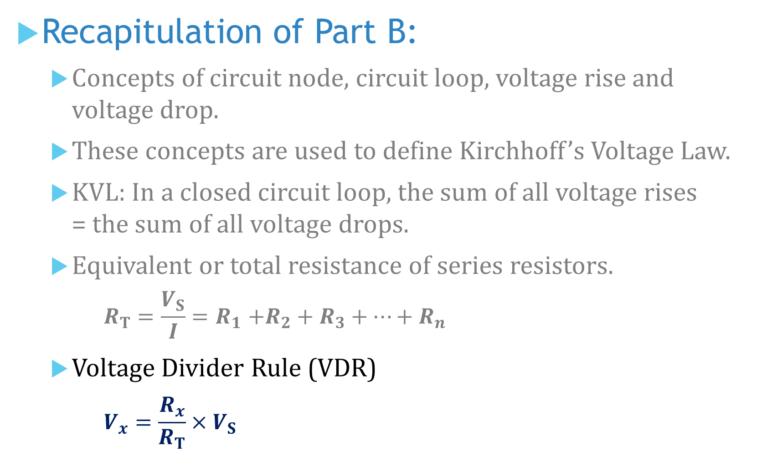
Recapitulation of Part B:
Concepts of circuit node, circuit loop, voltage rise and voltage drop.
These concepts are used to define Kirchhoff’s Voltage Law.
KVL: In a closed circuit loop, the sum of all voltage rises = the sum of all voltage drops.
Equivalent or total resistance of series resistors.
$$R_{T}=\frac{V_{S}}{I}{=R}_{1}+R_{2}+R_{3}+⋯+R_{n}$$
Voltage Divider Rule (VDR)
$$V_{x}=\frac{R_{x}}{R_{T}}×V_{S}$$

Slide 10
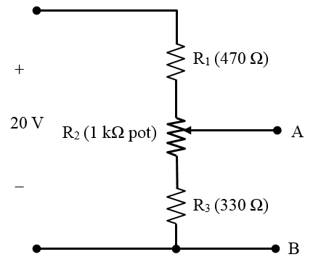


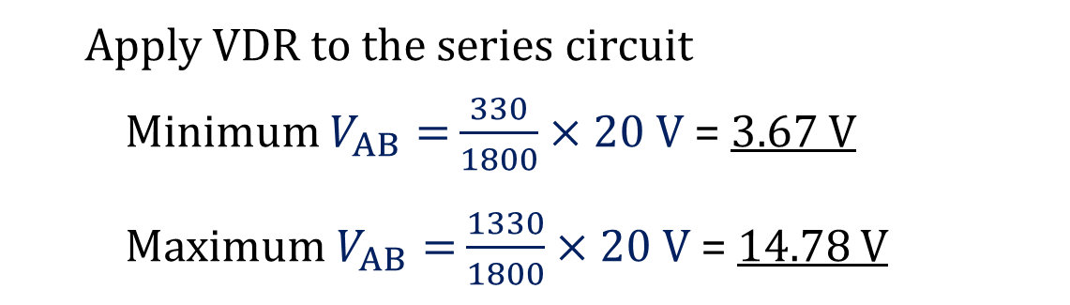
Example 4: What is the maximum and minimum voltage across A-B in this circuit?
Total resistance R_{T} = R₁ + R₂ + R₃
R_{T} = 470 + 1000 + 330 = 1800 Ω
Minimum R_{AB} = R₃ = 330 Ω
Maximum R_{AB} = R₂ + R₃ = 1000 + 330
= 1330 Ω
A
A
Apply VDR to the series circuit
Minimum $V_{AB}=$ $\frac{330}{1800}×20 V$ = 3.67 V
Maximum $V_{AB}=$ $\frac{1330}{1800}×20 V$ = 14.78 V

Slide 11
You have learned to
apply Ohm’s law, KVL, concepts of total resistance, and VDR for circuit calculations.

Slide 12
Coming Up Next
Voltage Measurement with respect to Circuit Ground

